Slide 1
A Guide to Facilitating Optimal Sensory Processing for Students
By Brooke Gentle, MS OT/L

Slide 2
Intended Outcomes - - - - - - - - - - - - - - - - - - - - - - -
To Introduce educators to:
Sensory Processing Theory 101
The neurological thresholds as they relate to sensory processing
Sensory modulation
General strategies for low and high thresholds
A Brief Overview of Sensory Behavior vs. “Traditional” Behavior
Environmental Change to Support Sensory Regulation
The Classroom
The Teacher and Education Assistant
Question & Answer

Slide 3
What is sensory processing?
Sensory processing refers to how the brain takes in, organizes, and then uses information received from our physical environment and our bodies. The information is received through our 8 senses.
Visual
Auditory
Vestibular
Tactile
Proprioceptive
Gustatory
Olfactory
Interoception
Notes:
Sensory processing is largely synonymous with sensory integration.
Sensory Processing refers to how the nervous system receives information from our physical environment and our bodies (using our 8 senses) and organizes that information in order to form a response.

Slide 4
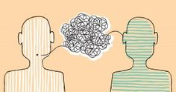
The Eight Senses
Visual – processing what we see
Auditory – processing what we hear
Vestibular – processing positional changes, balance, and movement
Tactile – processing info received through contact with skin
Proprioceptive – processing info from joints and muscles for body awareness and movement
Gustatory/Oral – processing info based on taste, mouth and jaw input
Olfactory - processing smell
Interoception – processing what our internal organs and body systems communicating
.
Notes:
Sensory processing is largely synonymous with sensory integration.
Sensory Processing refers to how the nervous system receives information from our physical environment and our bodies (using our 8 senses) and organizes that information in order to form a response.

Slide 5
What does it mean to have a “regulated” or well-modulated sensory system?

Slide 6
When a person’s sensory system is regulated, they are:
Comfortable
Calm
And demonstrate ability to:
Listen
Attend
Engage
Adapt
Respond appropriately
Notes:
When a child is well regulated, they adapt to changes in the environment; They have an appropriate level of nervous-system arousal and attention for the task; they respond to input needed for the task and ignore input not necessary for task.

Slide 7
In other words, in an optimally functioning nervous system:
Unnecessary stimuli is ignored
Necessary stimuli is identified
Emotions are recognized and moderated
Actions are considered
Impulses are withheld

Slide 8
What happens when a student’s sensory processing is compromised? (consider these “red flags”)
May struggle to learn efficiently
May struggle to regulate their emotions
May struggle to function at an age-appropriate level in basic daily activities
May struggle to build relationships or create positive social interactions
May contribute to difficulty with higher level integrative functions, like motor planning

Slide 9
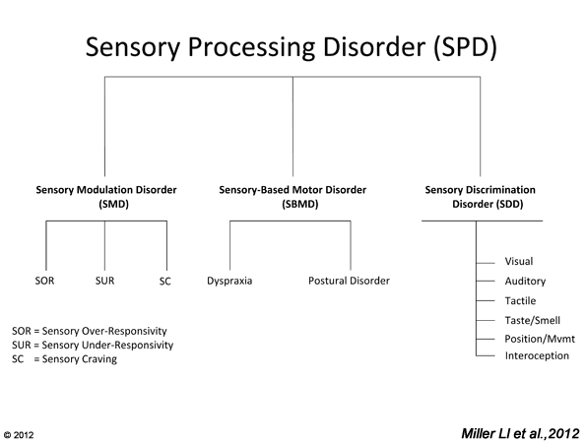
There are 6 possible subtypes
A child can be affected by 1 type, or all 6.
260,000 possible patterns of expression!
Treatment will not look the same for any two children.
Today we will focus on Sensory Modulation
Notes:
Symptoms of SPD vary greatly depending on the sense affected, the degree and way in which that sense is affected. A child can have one subtype, or be affected by all 6 types of SPD. A child can present with 1-2 senses affected by sensory discrimination disorder, or all 8. Ultimately, this results in 8 to the 6th power (over 260,000) possible patterns of expression of SPD. This is why individual assessment is ideal, and treatment will not look the same for any two children!
https://www.spdstar.org/basic/subtypes-of-spd

Slide 10
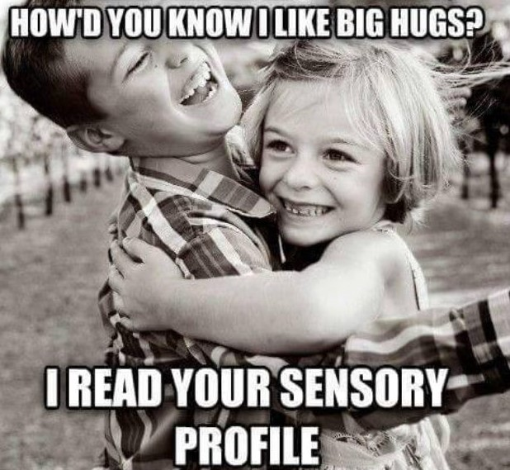
SENSORY MODULATION
Involves organizing sensory information within the nervous system, and generating a response.

Slide 11
The Neurological Threshold: Low vs. High
Low: Nervous system responds quickly to stimuli. May melt down easily. Tends to notice everything in environment. (i.e. can’t stop feeling the sensation of their shirt agains their skin)
High: Nervous-system responds more slowly. May need extra stimulation to reach arousal level in which they can make sense of the information they are receiving. May appear that they are not paying attention. (i.e. may put shirt on backwards without realizing it)
Low Threshold
High
Threshold
Notes:
Maintaining a balance between low and high thresholds is essential to be able to attend to what is needed for learning, and disregard what is not essential so as not to become overwhelmed.
Keep in mind, that thresholds vary depending on the flexibility of the sense. For example, a child might have a high threshold for auditory information, but a low threshold for tactile.

Slide 12
Sensory Modulation
[Involves organizing responses of the nervous system (balancing sensitization and habituation) to allow for an appropriate response to a stimulus.]
Over-responsive:
Neurons firing too frequently or quickly - takes little stimuli to reach threshold. (intense, exaggerated responses to sensory events)
Under-responsive:
Neuronal firing is slower - takes a lot of stimuli to reach threshold. (muted or slowed responses to sensory experiences)
Low Threshold
Sensitization
Over-responsive
High Threshold
Habituation
Under-responsive
Notes:
Keep in mind that individuals don’t have just one neurological threshold. One might operate in the middle of the continuum for visual stimuli, and demonstrate a high threshold for auditory information.
If this were the case, what might one do, to help the child find balance so they can learn?

Slide 13
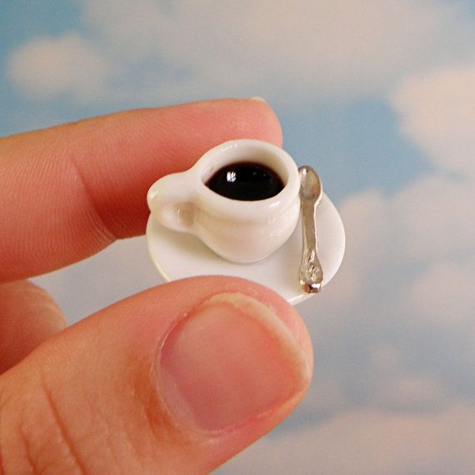
How big is your neurological threshold cup? (how much sensory input do you need to feel “just right”?)
Lower Thresholds
Higher thresholds

Slide 14
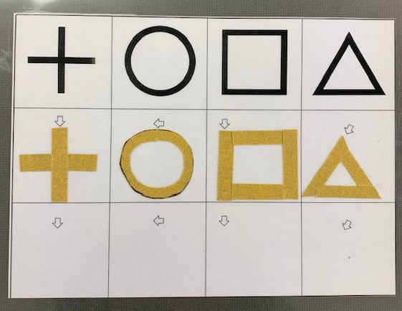
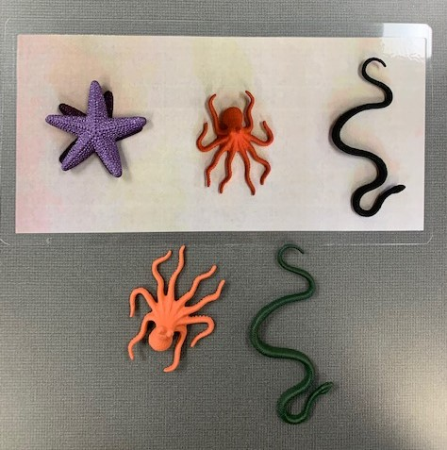
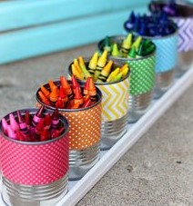
General strategies for those with a high threshold:
Add sensory information!
Integrate contrast for what you want the child to visually focus on
Add a tactile component
Add movement
Add noise/song
If a child is working on a matching or sorting, use actual items when possible (i.e. match item to picture)
Use their interests as a bridge
For communicating, use visual first; then auditory; then tactile.
Sandpaper finger tracing
Notes:
(i.e. if learning shapes, perhaps there is a black background to contrast with the color of the wooden pieces; perhaps the outlines of where wooden pieces go are outlined on the black paper with glitter (tactile + visual); perhaps the child is reaching in the box that the teacher is shaking, to obtain the wooden piece (auditory, movement)a

Slide 15
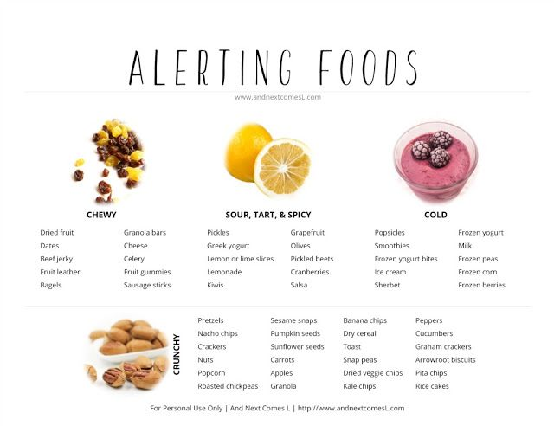
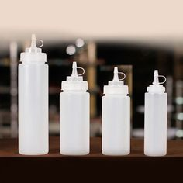
General strategies for those with a high threshold:
Add sensory information!
Add vibration as an alerting tool (i.e. battery operated Toothbrush; cushion)
Offer alerting snacks
Cold or frozen foods/drinks; chewy foods; crunchy foods (i.e. pretzels, carrots); sour, tart, or spicy (i.e. salsa, pickles, greek yogurt)
Integrate smells for increasing alertness
Can use concentrate on cotton balls, in condiment containers.
Notes:
(i.e. if learning shapes, perhaps there is a black background to contrast with the color of the wooden pieces; perhaps the outlines of where wooden pieces go are outlined on the black paper with glitter (tactile + visual); perhaps the child is reaching in the box that the teacher is shaking, to obtain the wooden piece (auditory, movement)

Slide 16
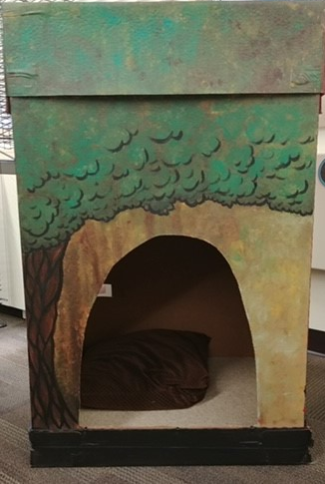
General Strategies for those with a low threshold:
Reduce stimulation (environment is key)
Create a cozy hiding spot
Teach how to take a break. Schedule breaks. Allow upon request to validate communication and attempts at self-regulation, even if overused at first.
Opportunities for deep pressure input, such as crawling, rolling, pillow crashing, jumping, bouncing, a “squeeze”, lycra tunnel/bag, pushing/pulling a cart or wagon with items in it, carrying items with weight (deliver a package to office?)
Notes:
These children tend to be easily overstimulated, so reducing stimulation to simplify activity is ideal (environment is key for these children)

Slide 17
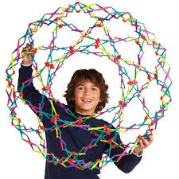
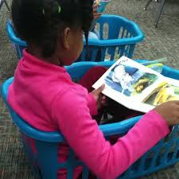
General Strategies - low threshold:
Teach deep breathing (pair with a visual) so that it can be utilized as a self-regulation tool.
Move to quiet music - simple repetitive patterns (calming) (i.e. “Me Moves”)
Provide alternative spaces to learn that provide deep pressure (proprioceptive) input
Imperative to find the “just right” challenge (too easy or too hard, and you may lose them)
Notes:
These children tend to be easily overstimulated, so reducing stimulation to simplify activity is ideal (environment is key for these children)

Slide 18
Sensory Related Behavior vs “Traditional” Behavior
Every challenging behavior indicates communication of a positive need. It is our job to identify what that need is.
Indicators of a “Traditional” Behavior:
The child looks for your reaction during/just after the behavior
The child calms down pretty immediately after the need is met or attention is given.
The child responds to firm, consistent consequences (i.e. stops throwing toys when toys taken away after he throws).
Notes:
Remember that all behavior is communication. Unfortunately, there no easy way to identify a behavior as sensory related or otherwise, without breaking it down and considering how the child functions in multiple environments. It is important to identify what the root of the behavior is. Sensory interventions generally are not going to work to remediate a non-sensory behavior.
try to focus on what you want to see the child do (i.e. Naomi)
If we put a child in “break” every time they hit someone, they are learning to get out of the uncomfortable situation by hitting. So, come back to what you want to see happen, and work on making a plan. Set up their play on the edge of the carpet away from other kids, then pull a peer in to play with something the child finds motivating, and make sure there is enough of the toy to go around; once this is tolerated, model how to “trade”.

Slide 19
Traditional Behavior vs “Sensory” Behavior
Indicators of Sensory Related Behavior:
does not respond to typical and consistently applied interventions such as limits, natural or imposed consequences, verbal reasoning, reward systems or social influences.
does not change their behavior immediately but instead the behavior dissipates slowly as triggers are removed and their nervous system recovers
does not pay attention to those around them or modify their behavior based on another person’s immediate response.
Caveat: Some sensory behaviors can become increasingly dysregulated with more of the stimulus than the child is seeking, and the child may recover more immediately after stimulus is removed - appearing behavioral, when in fact, it is sensory related.
Consider that all behavior is to obtain or escape something
Notes:
Remember that all behavior is communication. Unfortunately, there no easy way to identify a behavior as sensory related or otherwise, without breaking it down and considering how the child functions in multiple environments. It is important to identify what the root of the behavior is. Sensory interventions generally are not going to work to remediate a non-sensory behavior.
Frequent reasons for Sensory Meltdown:
Sensory overload
Dysregulation and the inability to maintain self-regulation and a ready state
"Fight or flight" response to sensory overload, yet mistaken for a standard, behavior driven meltdown
The inability to cope with a new or challenging situation
Inability to communicate wants and needs
Difficulty with transitions
Lack of sleep or over tired
Lack of proper nutrition or too much of the wrong food
Change in routine
Rather than focus on eliminating the behavior, try to focus on what you want to see the child do. For example, if a child hits every time another student comes near them, rather than working on not hitting, work on helping that child feel comfortable allowing other people into their space.
If we put a child in “break” every time they hit someone, they are learning to get out of the uncomfortable situation by hitting. So, come back to what you want to see happen, and work on making a plan. Set up their play on the edge of the carpet away from other kids, then pull a peer in to play with something the child finds motivating, and make sure there is enough of the toy to go around; once this is tolerated, model how to “trade”.
Identify specific behavior
Look at antecedent and consequence

Slide 20
Consider the Environment First:
The Classroom
Often, we think of things to change the child, but what else can we change?
Notes:
The environment should be the first thing to address when you sense there are sensory challenges. What can you do in your space to make it place where optimal learning can occur?

Slide 21
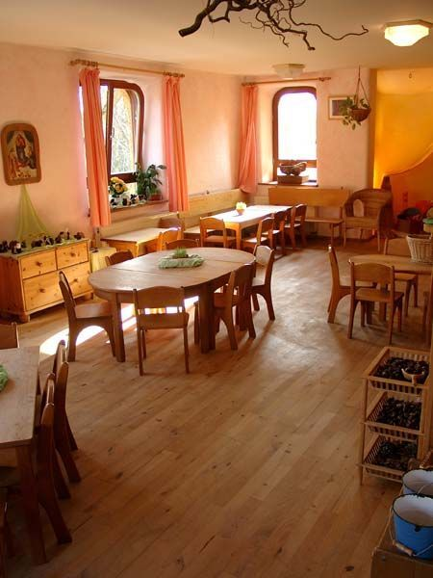
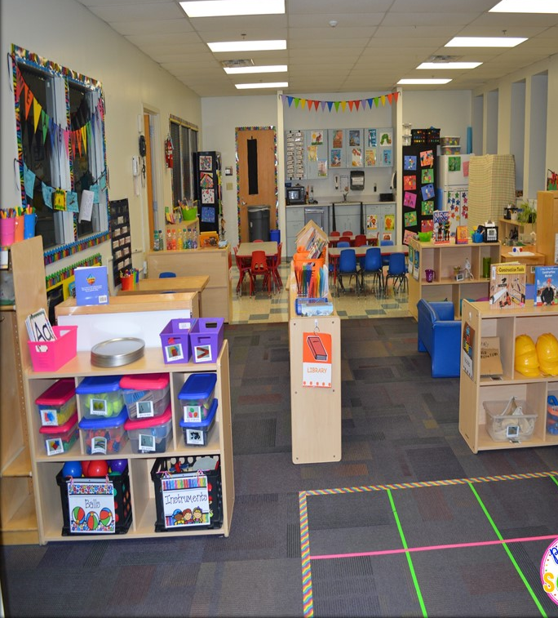
vs.

Slide 22
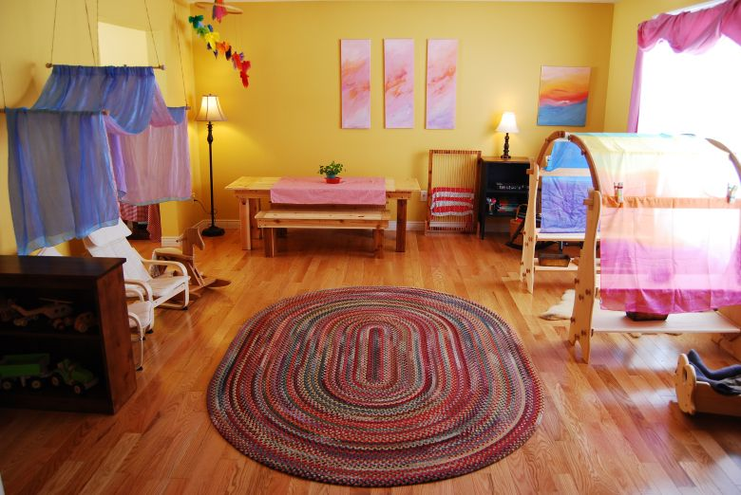
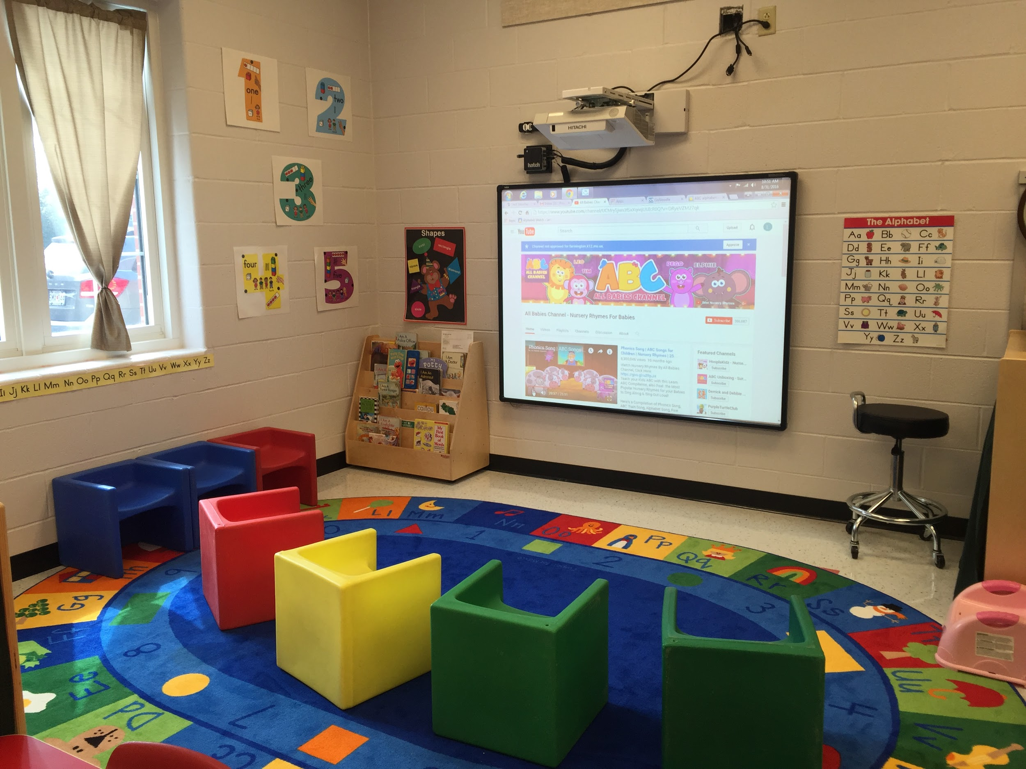
vs.

Slide 23
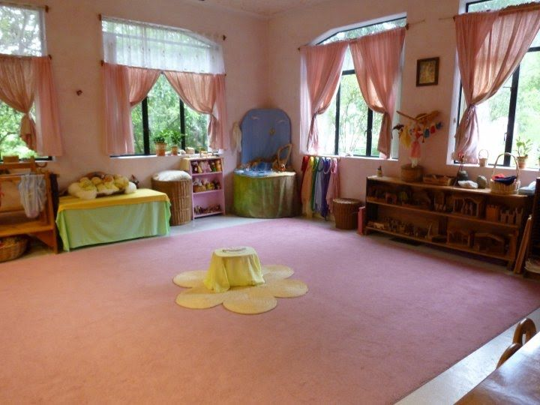
VS.

Slide 24
Consider the Environment First:
The Classroom
Limit the toys/work items available/visually available.
Limit information on wall space - less “busy” is better.
Consider amount of space in room - Is it too crowded (with stuff or students) for certain children to feel safe/comfortable? Are there less populated class options?
Consider wall color - light warm hues, such as a soft warm coral.
Keep classroom furniture and object colors neutral, and use the bolder colors for the tasks you want them to focus on for learning.
Often, we think of things to change the child, but what else can we change?
Notes:
“green with envy”; “seeing red”; “feeling blue,” a “black mood” all exist in literature and our everyday conversations for a reason - colors truly affect feelings.
Pink is a loving, innocent color, decidedly feminine in character. Therefore, it is a natural color choice for the daily embracing of this age group.

Slide 25
Consider the Environment First:
The Classroom
Consider lighting - utilize natural light when possible; Softer light; Is there a dark place (tent, box) where one can escape light?
Consider Glare: Glare, especially on laminated items can cause a distraction. Laminate sparingly, or use sandpaper to dull the glare. Use a chalkboard over a white board, if you have the option.
Avoid busy patterns - they can be overstimulating and distracting.
Minimize the use of bold colors (draining on the eyes)
Utilize warmer colors, and natural textures and fibers when possible.
What would your dream classroom look like?
Often, we think of things to change the child, but what else can we change?
Notes:
Incandescent lightly, offset lighting, using filters.
As much natural light as possible, and if, as in most classrooms, there is only one wall of windows, counter that light with soft light on the opposite side of the room to so visually it is not “lopsided” - when light enters from two sides of the room, you have to axises of light and it puts the room at rest. When you have a single axis of light, such as one wall of windows, it can become a restless line force leading attention out of the room. Translucent curtains can diffuse light and direct it further into the room.
Also, consider that whatever the light source, the colors of the surfaces of objects in the room will contribute strongly to the feel of the room -
When colors are bright and intense it can be draining on the eye.
Bright colors can be used sparingly and most effectively when they appear in contrast with the warm natural colors! You can spotlight what you want them to focus on that way.
Scale and porportion - we are all affected by this, whether it is conscious or not. We can be affected positively or negatively - if negatively, we may fear the space and will want to “escape”. Those kids who can verbalize, may say “it doesn’t feel right”. Many classrooms have been designed for older childrene and adults. Chalkboard, window sills, and coat hooks are too high; Bottom half of walls are often painted a dark color, the furniature is too big, and the shelves are out of reach. The radiators are large, and the lighting is all on the ceiling. The horizon is set high, for bigger people.
There is also the problem of an institutional look. Children feel this right away because they see a contrast to their home environment. Lack of spatial variety; hardness of surfaces; They are used to smaller, warmer, interconnected spaces.

Slide 26
Consider the Environment First:
The Classroom
Furniture placement
Will Johnny feel comfortable working at the corner workstation where there is only one way to “escape” if he feels unsafe? (avoid “dead ends”)
Will Annie be able to remain sitting at carpet with the big open space behind her, or will she feel compelled to run? (i.e. move bookshelf behind carpet to form barrier)
Is Clair, who is cautious and tends to experience a low threshold, going to be able to successfully complete that fine motor activity at the table if she can’t feel the ground under her feet? (obtain foot support, or better yet - lower the table or find a different chair)
The classroom routine
Use a visual schedule for predictability.
If you start with what they CAN do, they will perceive future success. If you start with what is hard, they will perceive future failure.
Alternate short periods of movement with quiet activities.
Avoid force (refusal is communication of discomfort)
Often, we think of things to change the child, but what else can we change?
Notes:
If using the toilet is new and anxiety provoking for a some students, is it ideal to start the day off with bathroom trips?

Slide 27
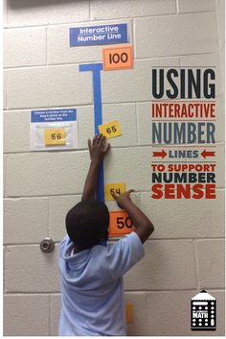
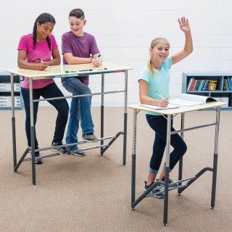
Consider the Environment First:
The Classroom
Arrange space so that eye contact and communication naturally occur.
Workstations: Use horizontal and vertical planes.
Allow a child to work in different positions (bean bag, lying on floor, sitting in laundry basket, standing).
Have a sensory retreat with soft pillows, perhaps a weighted toy or blanket. Allow the child to come out when they are ready.
Make sure you have a space for large motor movements.
Never take away recess for behavior management
Often, we think of things to change the child, but what else can we change?
Notes:
If using the toilet is new and anxiety provoking for a some students, is it ideal to start the day off with bathroom trips?

Slide 28
Consider the Environment First:
The Teacher & Education Assistant
Your tone and volume of voice - and what the child you are working with needs - more animation for high thresholds; less volume and animation for lower thresholds.
Limit unrelated conversations with other adults present - this time is dedicated to the children.
Let go of needing the child to like you. Ask yourself, is this for me, or is this for the child? (i.e., if the child can sit by themselves at circle, don’t offer to let them sit in your lap)
Limit praise when able, but certainly acknowledge when you witness something positive happen, especially if the child looks at you with pride.
Turn off notifications on devices - even vibrate. Silent mode is ideal, to limit distraction.
Often, we think of things to change the child, but what else can we change?
Notes:
If you are working with a child how tends to reach his thresholds more quickly, perhaps your tone of voice is softer and quieter. If you are working with a child who needs more input to reach a threshold for learning, break out the sing song voice and pair speaking with a tactile or visual cue.
Is it about you, or the child? Kindly ask yourself this. For example, I have some airplane earrings that Dylan would love and talk about non-stop. But it would also draw his attention from his work if I wore them. I will not wear the earrings, because it is more important for him to focus.
Limit praise. This is important for a couple of reasons. 1) If we are considering the whole child development, then we can’t forget that it is important for them to learn how to be motivated without a reward or an adult offering praise - - otherwise they can become dependent on adult feedback, and we want them to do things for reasons other than for reward. We want them to be independent, not just do what we want them to do. This kind of concept develops at a young age. If a child stacks blocks and looks at you with pride, consider withholding the “Good job!” and instead, smiling and saying “You did it. I see, you stacked.” Or, smile and clap, but fade that to just a smile.
It is also important to keep in mind that with praise, is it’s equal and opposite form, rejection. If something is “good”, it also has the potential to be “bad.” This can be anxiety provoking for children. “I did it correctly, but that was really hard for me, and I’m not sure I’m ready to do it every single time, but now that she knows and says it was good, she’s going to want me to be good more, and I’m not sure I can do that.” And then we have an unregulated child. When possible, simple acknowledgement the task was completed will often do.

Slide 29
Consider the Environment First: The Teacher/EA
What you wear can impact the child:
If the child has low threshold, avoid busy patterns, bold colors, noisy or shiny jewelry, or shoes that make noise when you walk.
If the child has a high threshold, perhaps you want to draw attention to your face or what you say by wearing bright lipstick, or what you are pointing at with a bright nail color.
If a child seeks the feeling of your skin or hair, wear long sleeves and put your hair back (and give them opportunities for tactile learning or proprioceptive input)
Avoid perfumes and scented lotions, but consider integrating scent into learning activities.
Often, we think of things to change the child, but what else can we change?

Slide 30
Consider the Environment First: The Teacher/EA
What you say matters. Are you asking them questions they cannot answer? Try not to.
Use words sparingly, with auditory processing under-responsiveness (high threshold for auditory) try one word directions paired with a visual - increase words used as ability to process improves.
Use direct eye-to-eye contact at the child’s level, whenever possible.
Be a calming force in the atmosphere - leave your stressors at the door.
Focus on the process not the product.
Avoid making children wait, to avoid eliciting a behavior. Plan for activities to be kept short, and gradually lengthen as familiarity with activity grows.
Often, we think of things to change the child, but what else can we change?

Slide 31
Questions?

